Slide 1
Positive Social Impact Tool (PSIT) – Charlotte Neighborhood Analysis
By: Saint Peter’s University

Slide 2
INTRODUCTION
Charlotte is one of the fastest-growing cities in the U.S., and with rapid development comes the risk of inequitable access to community benefits. By applying the PSIT framework, we ensure that growth is inclusive and evidence-backed.
This capstone project aims to map, measure, and visualize the Positive Social Impact Tool (PSIT) indicators across different ZIP codes in Charlotte. By integrating demographic, environmental, land use, and accessibility data, we highlight areas of need and opportunity.

Slide 3
KEY GOALS
Assess
Assess Community Equity: Understand disparities in public services, land access, and population well-being across neighborhoods.
Use
Use Data to Inform Design: Support planners, nonprofits, and decision-makers with evidence-based recommendations.
Visualize
Visualize Spatial Gaps: Identify areas lacking access to parks, clean air/water, or land banks.
Support
Support Smart Growth: Highlight ZIP codes with zoning and land-use potential to promote equitable redevelopment.

Slide 4
DATASET OVERVIEW
Contents and Organization:
The dataset consolidates key PSIT (Positive Social Impact Tool) categories across 24 ZIP codes in Charlotte.
Each worksheet section or row block captures a specific domain such as:
Identity: Race, ethnicity, age distribution, and veteran status
Wellness: Access to healthcare, environmental quality (air & water pollution)
Finance: Presence of land trusts, development zoning, conservation areas
Connectivity: Proximity to parks, transportation access
Resiliency: Crime rate indicators and environmental hazard zones

Slide 5
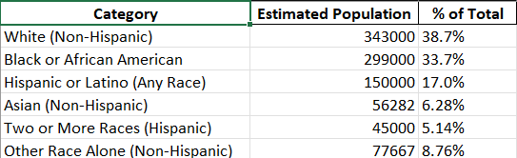
DEMOGRAPHIC INSIGHTS
Understanding who lives in each neighborhood is foundational to creating equitable and inclusive urban solutions. Demographic diversity informs community needs, service accessibility, and public investment priorities.
Category Estimated Population

Slide 6

METHODOLOGY
Steps:
Data Extraction using Pandas
Geolocation and mapping using Folium
PIST Score calculation based on proximity, zoning, access
Visualization of ZIP-level pattern
Tools & Technologies Used:
Pandas, NumPy – Data processing
Folium, Matplotlib – Geospatial and visual rendering
Excel & Geocoding APIs – Data sourcing & enrichment
Outcome: A scalable, data-driven framework that local governments and planners can use to prioritize investment, enhance livability, and drive social equity.

Slide 7
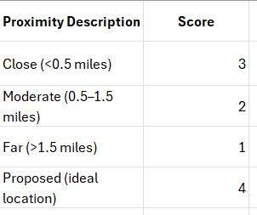
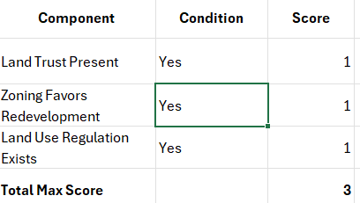
SCORING SYSTEM
connectivity
finance
The scoring for resiliency, wellness and prosperity goes same as that of connectivity.

Slide 8
LEGEND OF COLOUR CODING ACROSS VARIOUS CATEGORIES
Close to residents and high accessibility
Away from residents and low accessibility
Proposed location which has good accessibility and close to residents
Away from residents and no accessibility

Slide 9
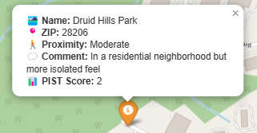
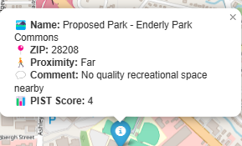
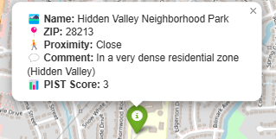
VISUALIZATION FOR WELLNESS
"Low density residential; mixed walkability" — This is a contextual note indicating that the surrounding area has spread-out housing and inconsistent pedestrian infrastructure. This lowers its accessibility and impact.
Location-based Insight: This park is a high-impact location in ZIP code 28213, likely contributing positively to residents' wellness and community accessibility.
Far – Residents currently do not have a park nearby. This area lacks accessible green space within walking distance.

Slide 10

VISUAKL
“Suburban; access by driving mostly” – The above video suggests that the surrounding area is suburban in nature, and the park is not well-integrated into walkable or transit-accessible infrastructure.
Far – The park is not easily accessible by walking for the majority of residents nearby. It likely requires a car to reach. So we need to develop this areas

Slide 11
CONCLUSION & RECOMMENDATIONS
Summary of Contributions:
Created a multi-layered dataset aligned to the PSIT framework
Scored and mapped ZIP-level indicators across identity, wellness, Finance, resiliency, and prosperity
Identified gaps in service and proposed targeted park/zoning interventions
Recommendations:
Prioritize underserved ZIPs (low scores) for public investment
Use land/zoning filters to propose redevelopment zones
Expand this model to other cities or counties

Slide 12
THANK YOU

